Slide 1
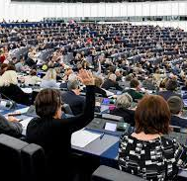
Slacking Parliamentarians?
#Bad Data and Tentative conclusions

Slide 2
/TABLE OF CONTENTS
/01
/OUR TOPIC
/02
/KEY ELEMENTS OF CODE
/03
/DIFFICULTIES
/04
/CONCLUSION
Context, Research Question, Data
Our Choices
Some of the compromises we had to make
What did we conclude for this data set and how might this be done better
INDEX.HTML

Slide 3
/01
/OUR TOPIC
Context, Research Question,
Data availability
INDEX.HTML

Slide 4
Working on gender with legal data
A first attempt with trials, but a lack of data
A new choice: the minutes of the European Parliament's plenary assemblies
Why the European Parliament?

Slide 5
Background information
Women vote more than men in general elections
There is still a discrepancy between men and women in the EU parliament
“A cold and thankless place” → Few MEPs gain fame and many MEPs have outside jobs
Impact of Maternity leave → several female MEPs were out for more than a year.

Slide 6
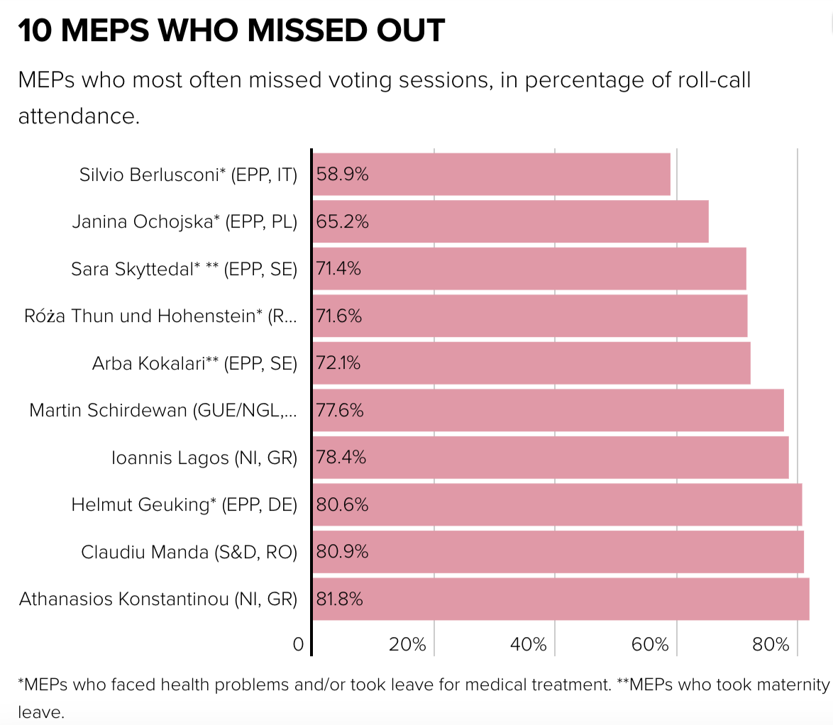
Some parliamentarians have bad attendance record

Slide 7
Can we detect a difference in the rate of MEPs who are “not participating” in the votes, according to gender?

Slide 8
/02
/OUR CODE
What were the steps of our code, what were the choices we made and why?
INDEX.HTML

Slide 9
/OUR CONCEPT
[1] IMPORT THE MINUTES
[2] IMPORT PARLIAMENTARIANS
[3] CLEANING PARLIAMENTARIANS
[4] CREATE ARCHITECTURE
[5] IMPLEMENT THE PROGRAM
[6] TEST AND RESULT
From the 8th legislature (2014-2019)
Accessing the complete list
From 751 to 636
Creating code based on fake data
Connecting all the pieces tgt.
Results?
INDEX.HTML

Slide 10
1/ IMPORT MINUTES
INDEX.HTML

Slide 11
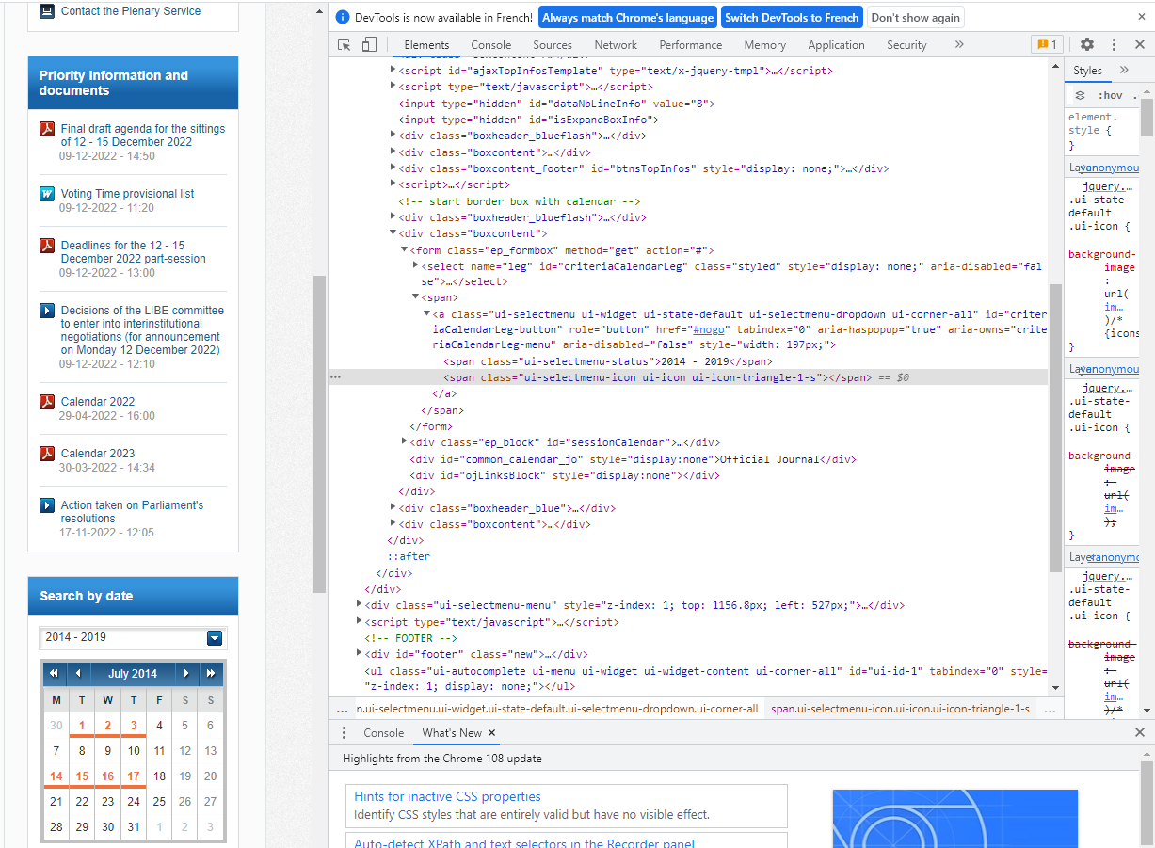
Select the correct dates and click on the orange ones with selenium?

Slide 12
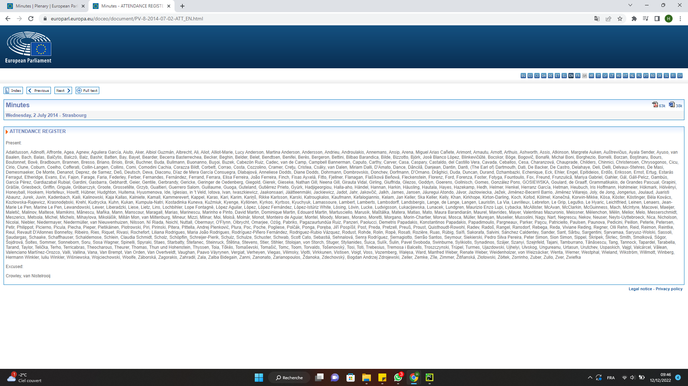
Minutes: example 1

Slide 13
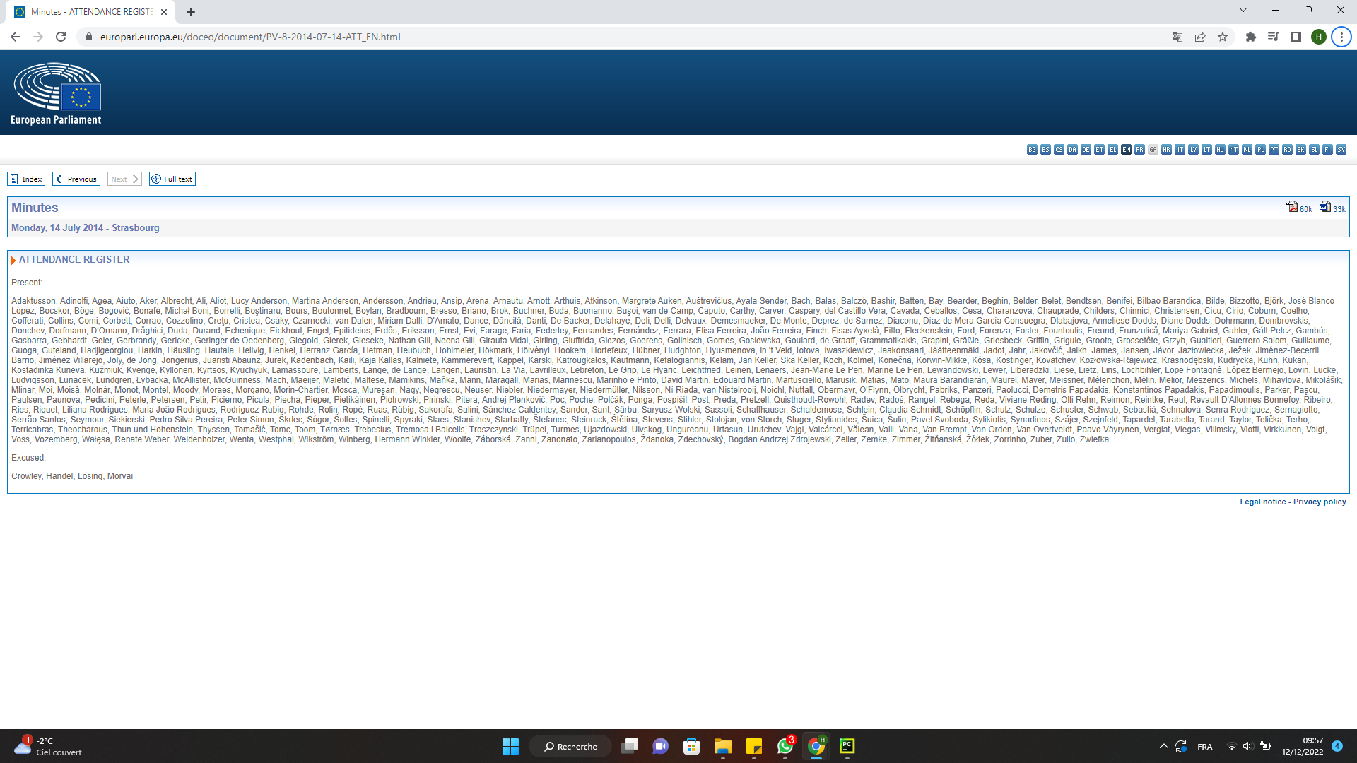
Minutes: example 2

Slide 14
Pattern of the urls
Turning the pattern into a code:
url = "https://www.europarl.europa.eu/doceo/document/PV-8-" + str(y) + "-" + str(m).zfill(2) + "-" + str(d).zfill(2) + "-ATT_FR.html"

Slide 15
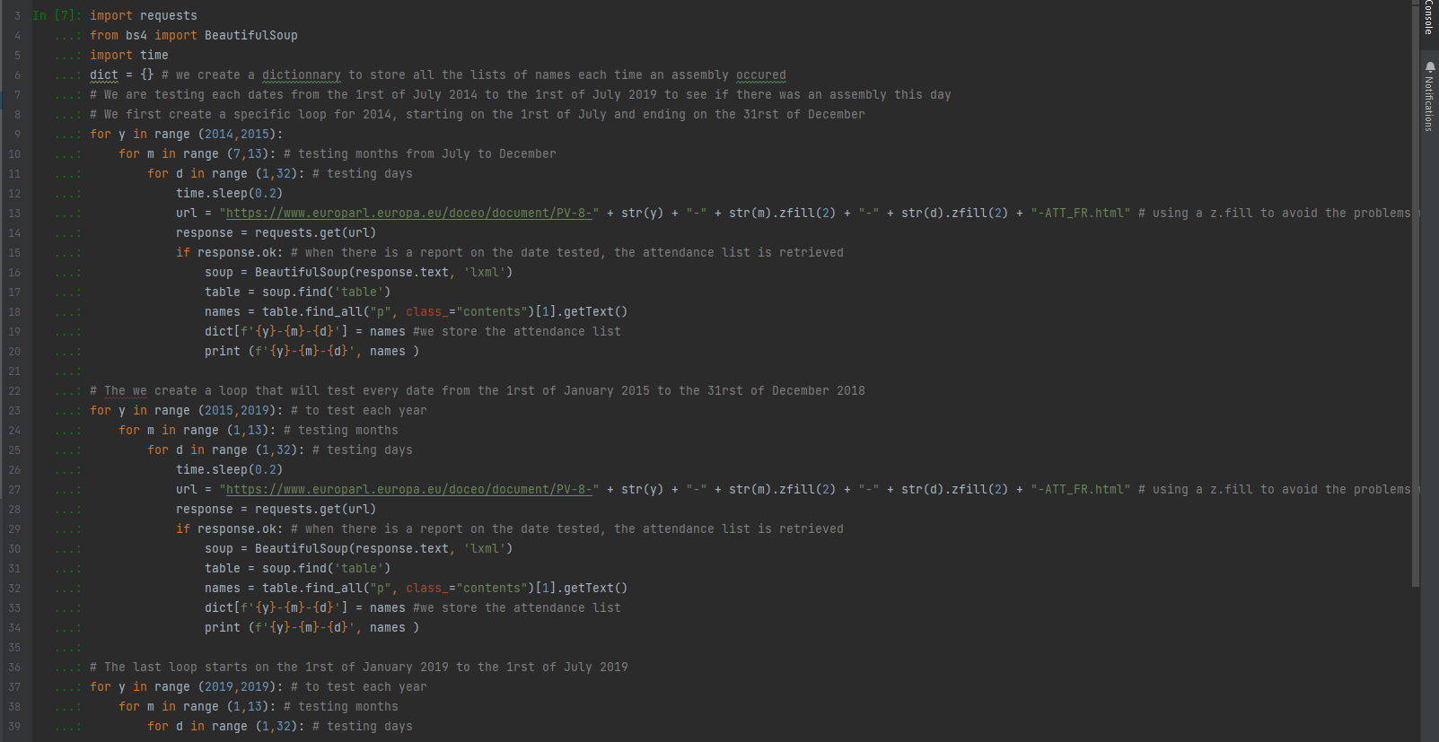
Creating a loop (well, 3) to test each url and get the minute (if any)

Slide 16
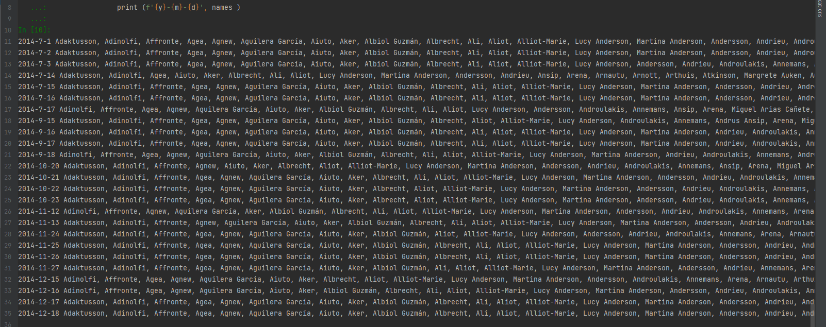
Results:

Slide 17
2/IMPORT MEPS

Slide 18
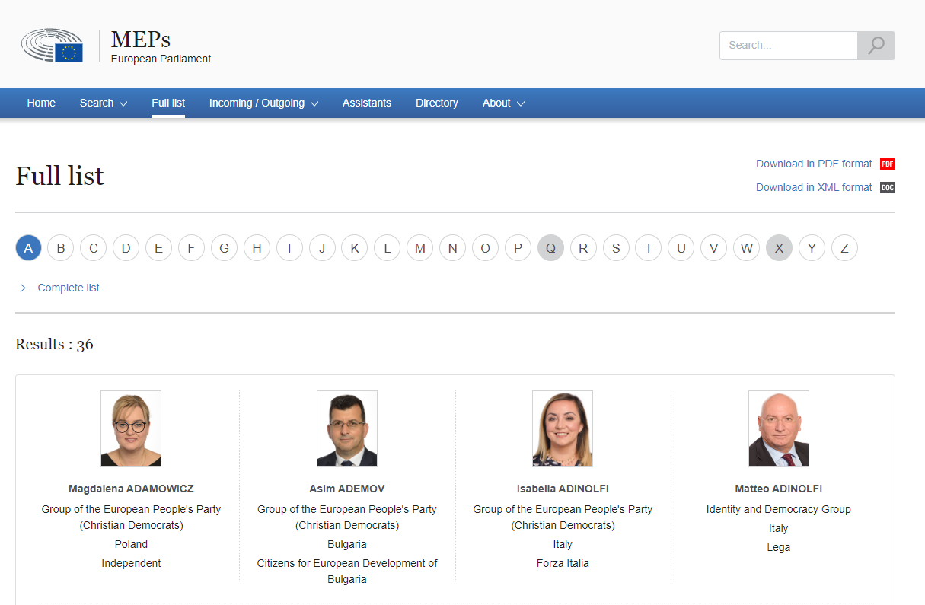
Finding the names
Available data: unsatisfactory

Slide 19
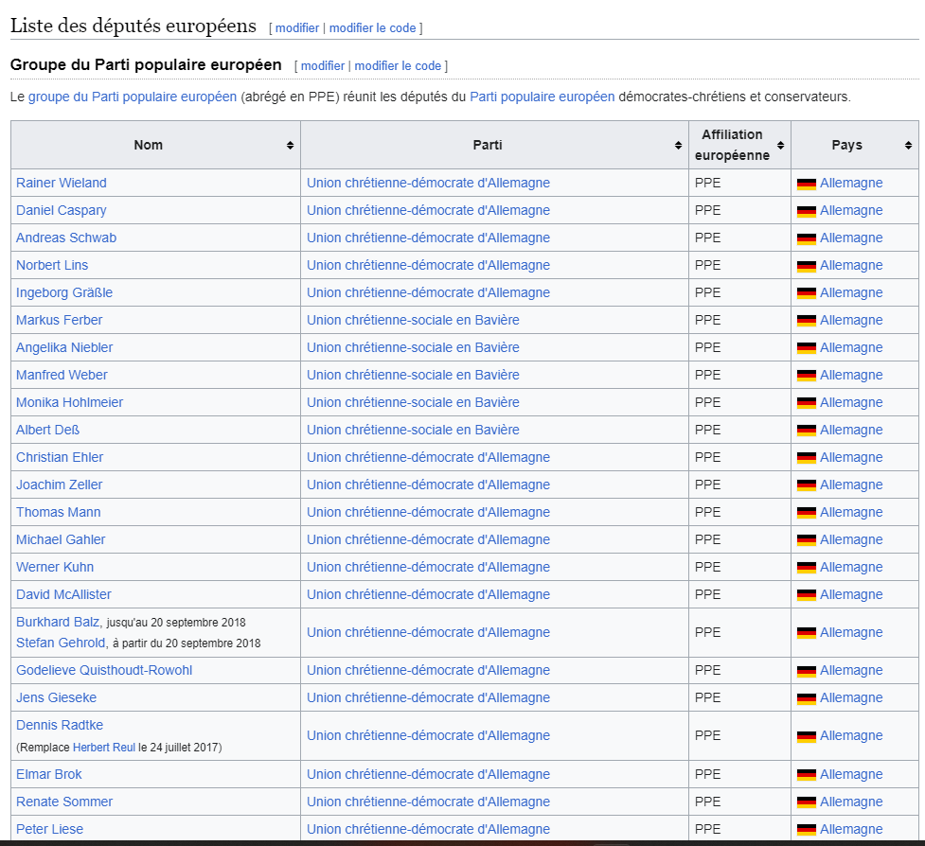
From this…

Slide 20
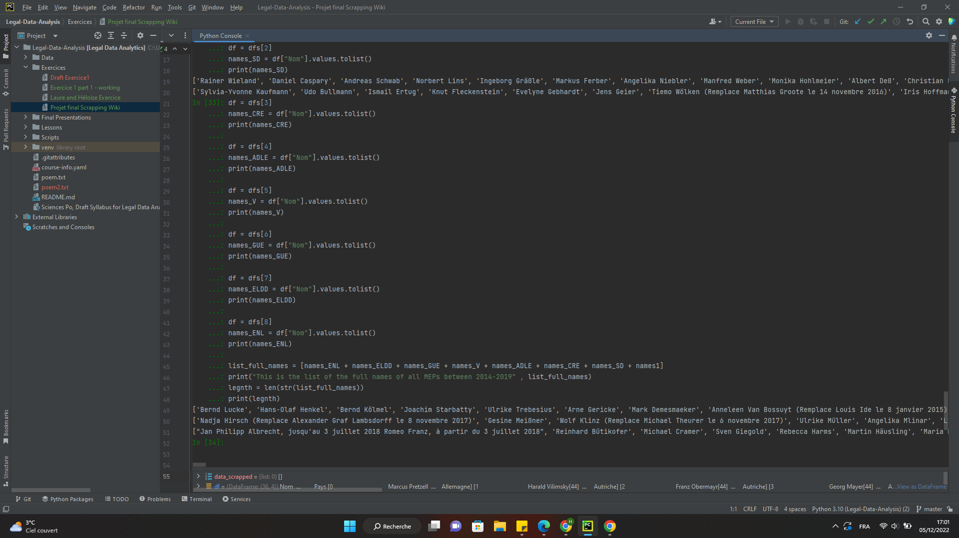
To this…

Slide 21
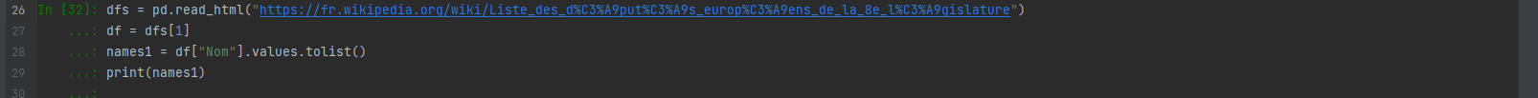
Repeated for each group

Slide 22
3/ DATA PROCESSING

Slide 23
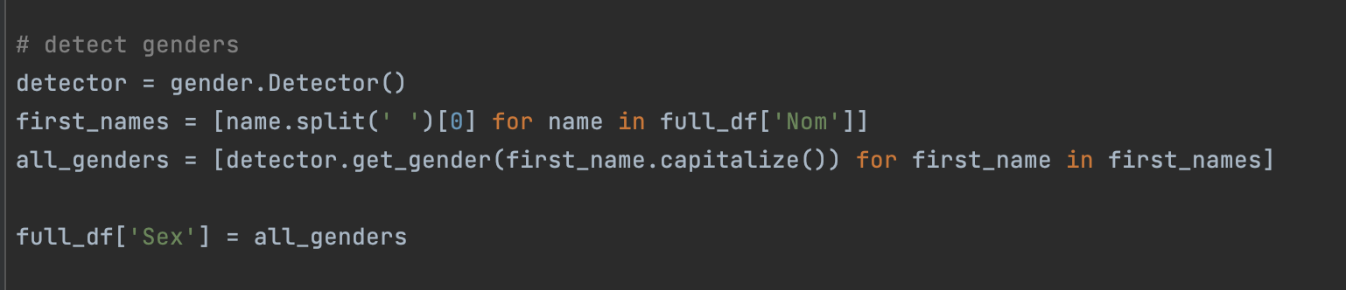
Finding the Gender

Slide 24
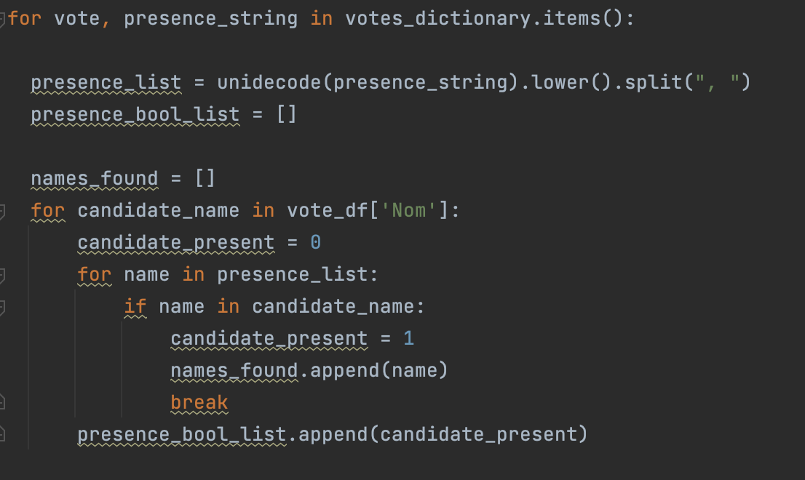
When did Who Vote?

Slide 25

/SOME FACTS
2 sets of scrapped data
255 decisions
637 MEPs
2 Data Frames
3 Types of collected data
3 Dictionaries
1 conclusion

Slide 26
/03
/DIFFICULTIES
A BLOOPER REEL
INDEX.HTML

Slide 27
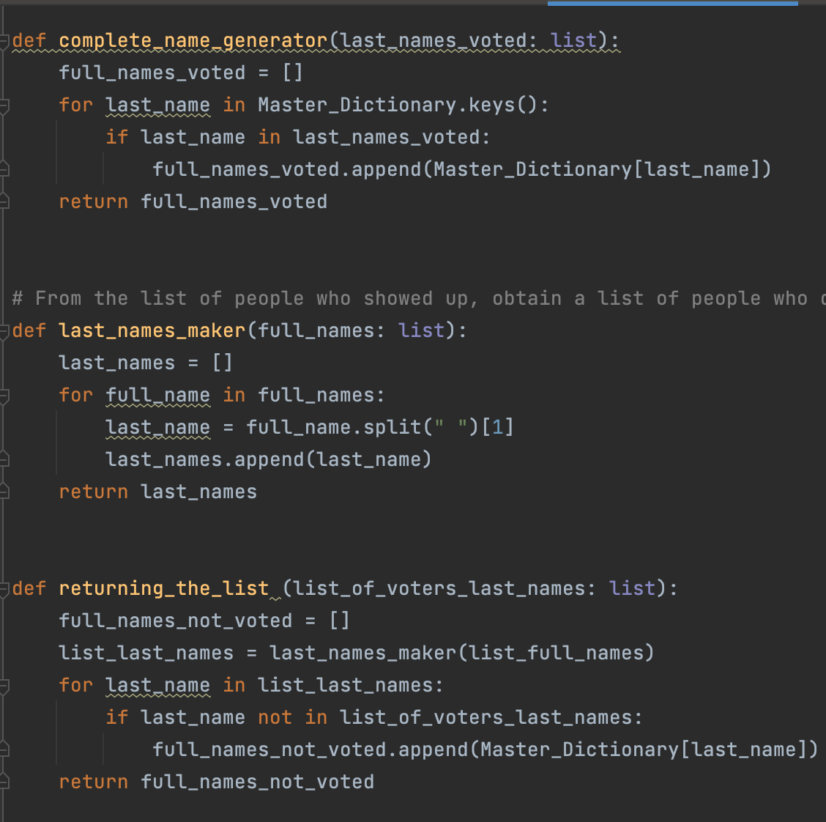
/A ?FUNNY? FIRST
ATTEMPT?
/DID YOU KNOW IT IS POSSIBLE TO WRITE A WHOLE DAY OF CODE THAT TURNS OUT TO BE USELESS?
/LEXICON AND OBJECTIVES
Venus has a beautiful name and is the second planet from the Sun. It’s hot and has a very poisonous atmosphere
A first attempt at working with functions and loops to process the data into various dictionaries
→ without the data frames
INDEX.HTML

Slide 28
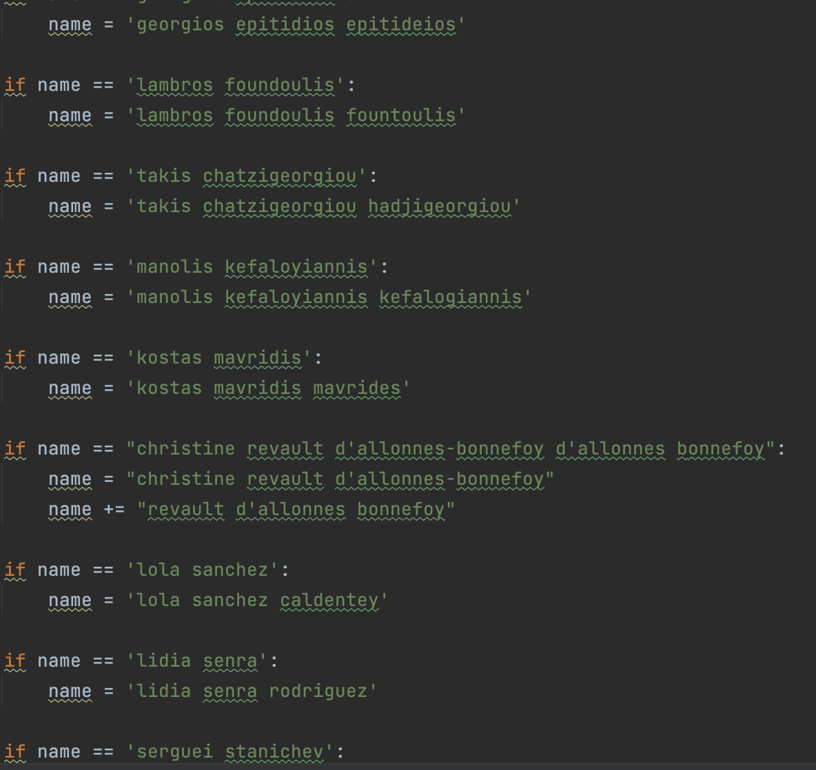
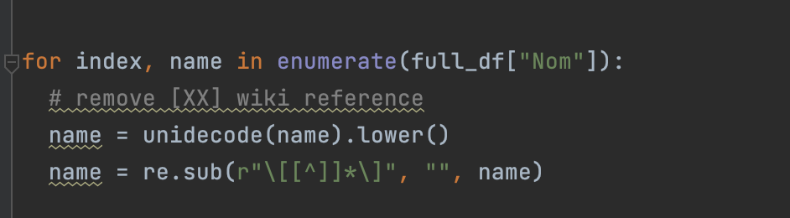
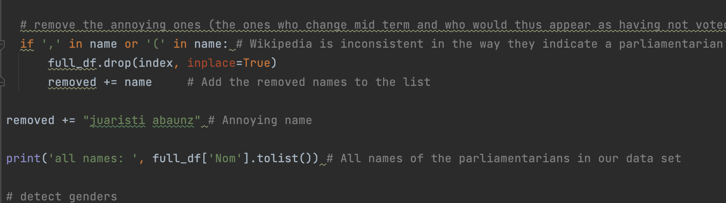
/CLEANING BAD DATA
/DID YOU KNOW WIKIPEDIA DATA IS UNCLEAN?
/LEXICON AND OBJECTIVES
About 30 names needing to be manually changed
Presence of Suspicious names: names that could not be connected in the data
MEPs who changed mid-term
Venus has a beautiful name and is the second planet from the Sun. It’s hot and has a very poisonous atmosphere
INDEX.HTML

Slide 29
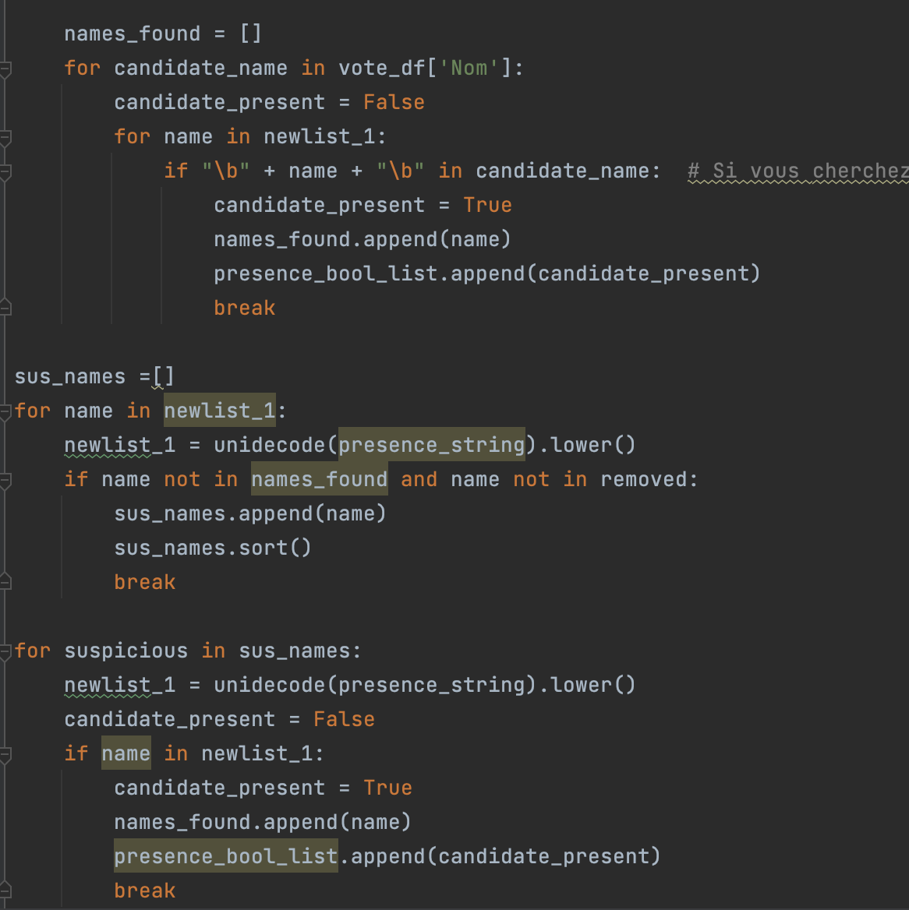
/CLEANING BAD DATA
YOUR LOGO HERE
/SUS Names
/LEXICON AND OBJECTIVES
Names that had not been removed from the data and had not been found in initial runs
→ manual clean so that the names matched
→ problem not entirely solved yet
Venus has a beautiful name and is the second planet from the Sun. It’s hot and has a very poisonous atmosphere
previous failed attempt
INDEX.HTML

Slide 30
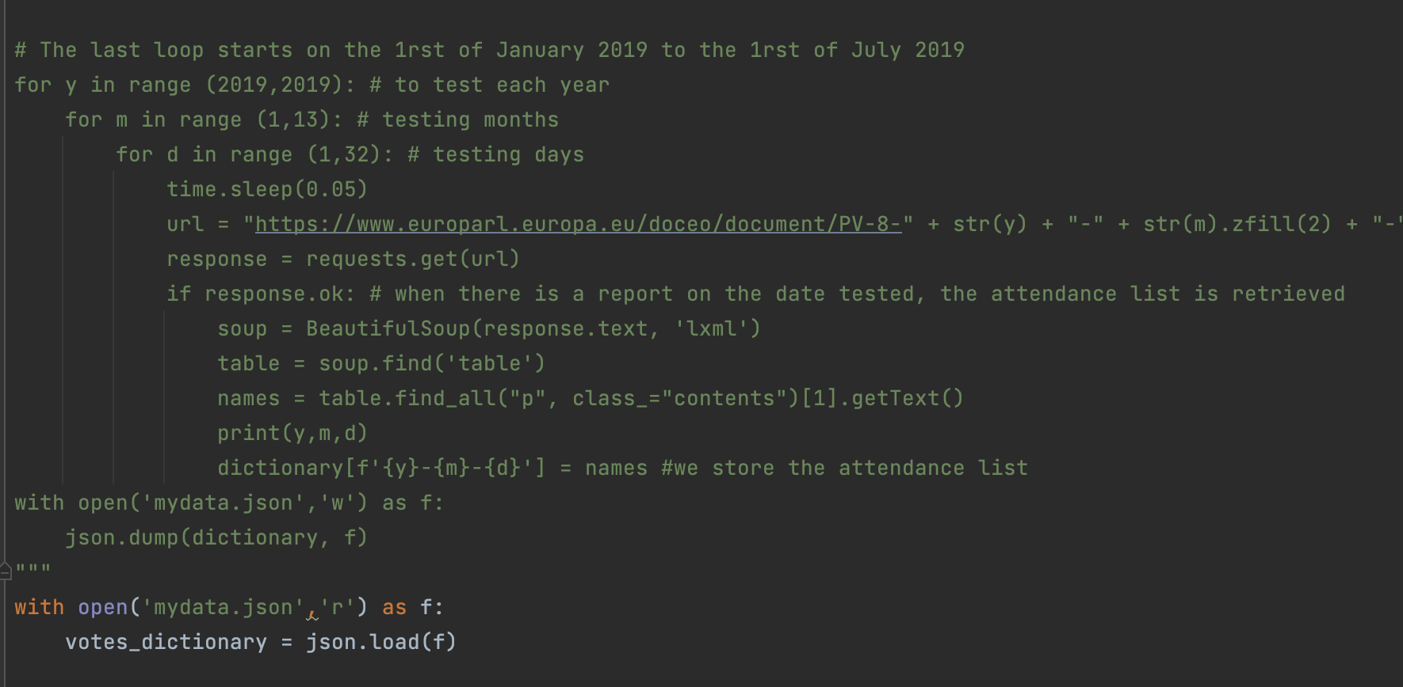
/CONNECTING OUR
WORK
/CONNECTING THE CODE
/LEXICON AND OBJECTIVES
While the formatting of the data and the code was consistent, it took about 45 minutes to run the code everytime. So it was difficult to make small adjustments
Venus has a beautiful name and is the second planet from the Sun. It’s hot and has a very poisonous atmosphere
previous failed attempt
INDEX.HTML

Slide 31
/REMAINING DIFFICULTIES
YOUR LOGO HERE
/THERE IS POTENTIAL…
/FACTORS WE KNOW ARE NOT ACCOUNTED FOR
We have data on countries and party affiliation but have not run significance testing …yet?
There are likely still problems with names that are not accounted for …yet?
Assign a country in the gender test
INDEX.HTML
Notes:
Detecting gender is often inconclusive → it would have been

Slide 32
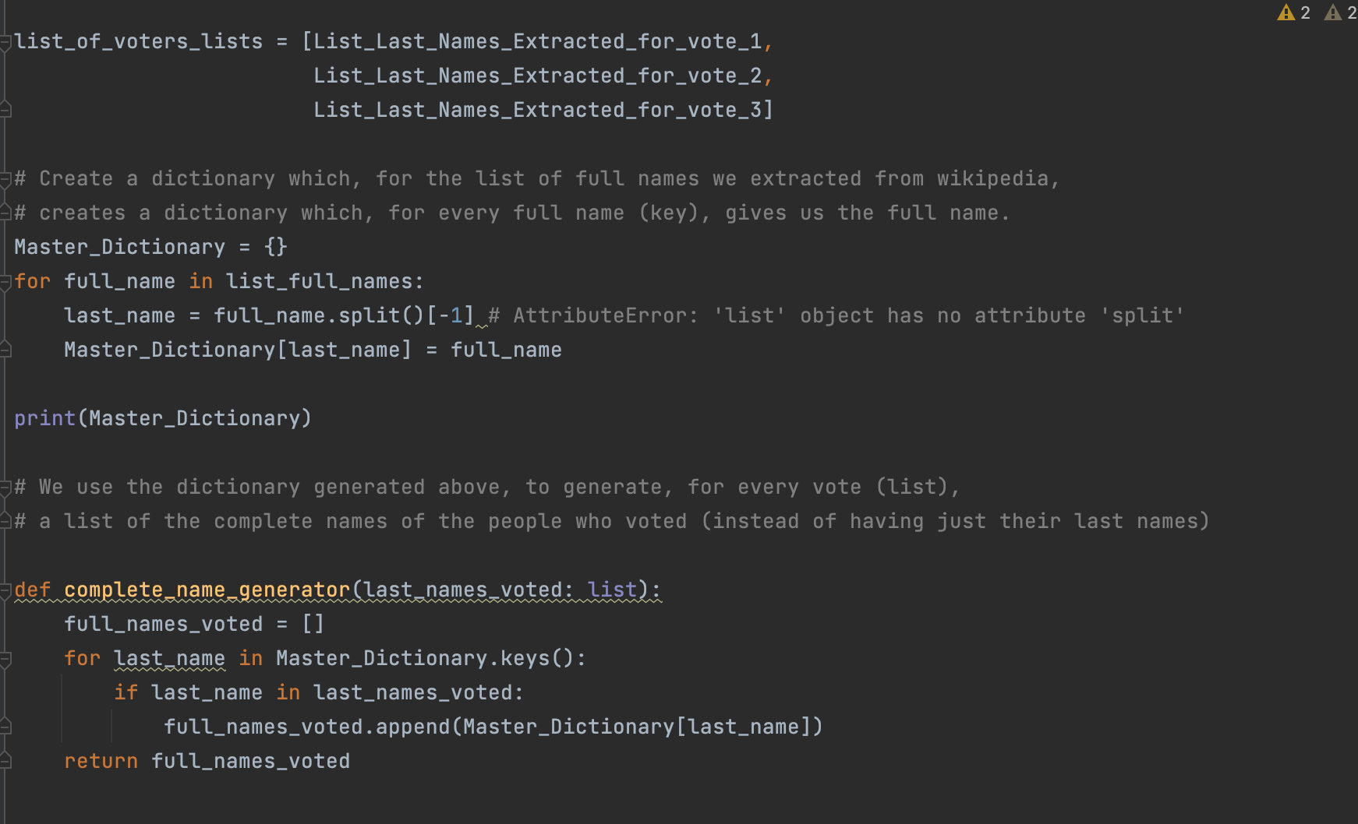
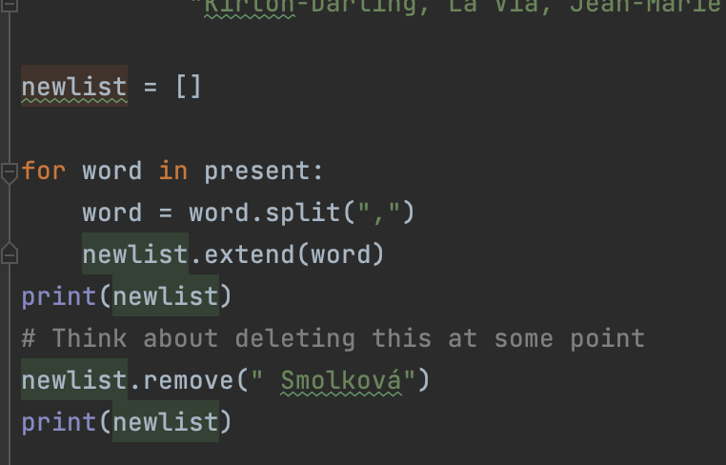
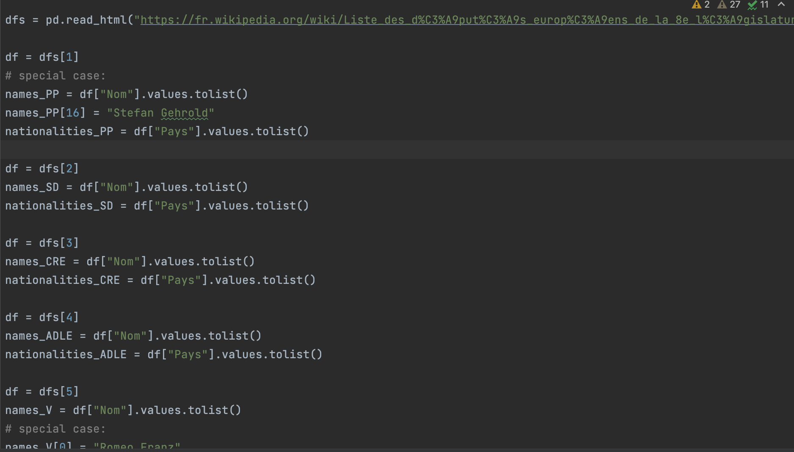
/NUMEROUS FAILED ATTEMPTS

Slide 33
/04
/CONCLUSION
At Last…
INDEX.HTML

Slide 34
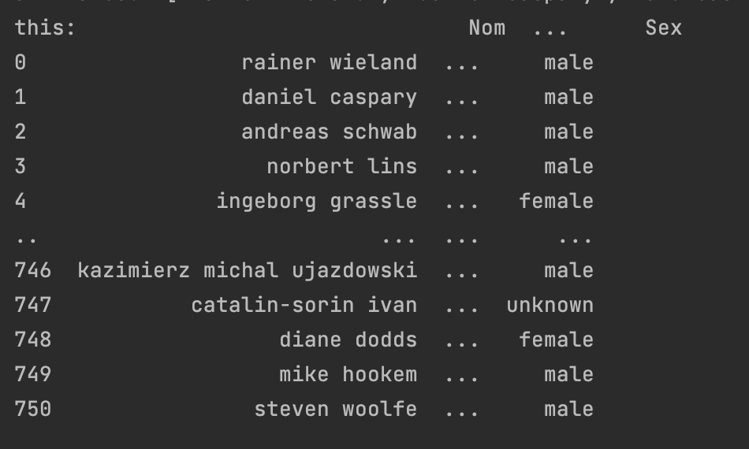
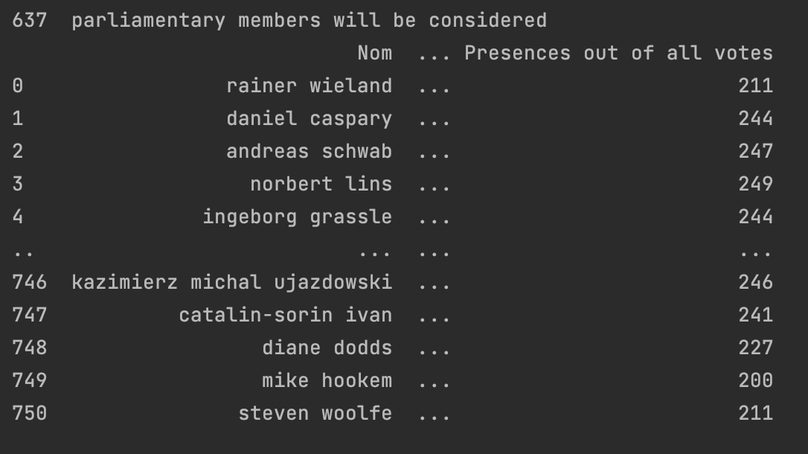
/OUR RESULT
Creation of data frames with the data…
Notes:
Inconsistent index (we removed some but the index is inconsistent)

Slide 35
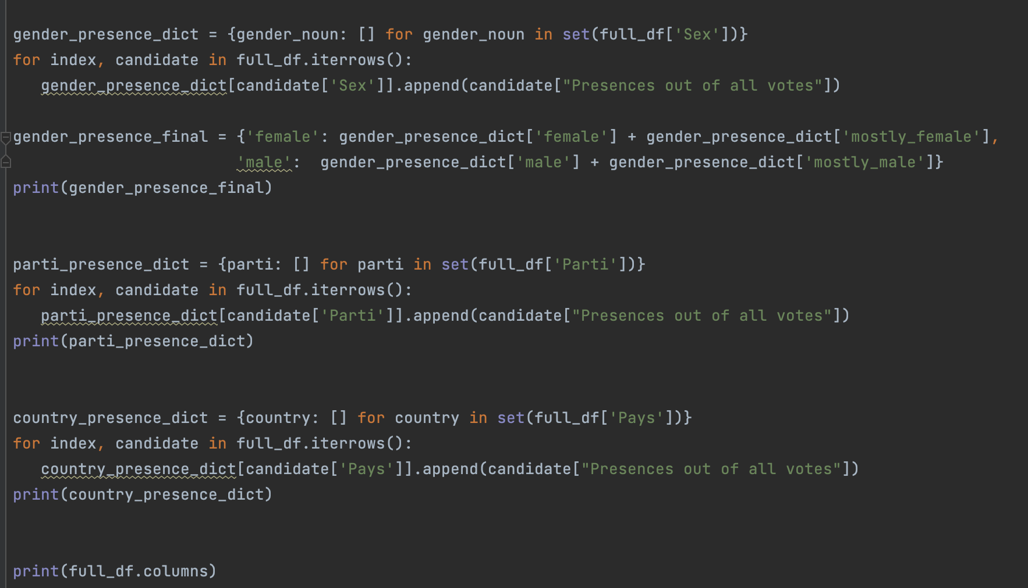
INTERMEDIARY STEPS: Making dictionaries to run a T-test

Slide 36
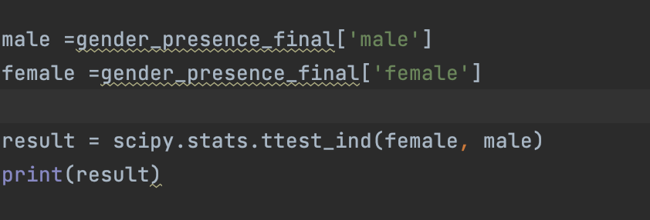
/OUR RESULT
/THERE IS NO DIFFERENCE
Men and Women show up in parliament to vote at the same rate…
Notes:
Inconsistent index (we removed some but the index is inconsistent)

Slide 37
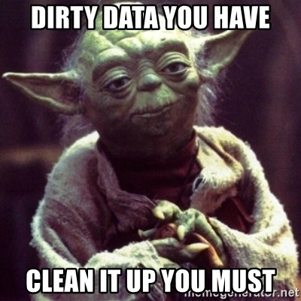
<bad data>
<difficulty>
INDEX.HTML
Notes:
Difficulty working with names: trait d’union, titles, long names, inconsistency, with names that are longer, weird accents, sometimes first names being included (super random) etc…
Assigning a gender to a name is surprisingly more difficult than planned → need to be based on the first name (which are not in the attendance lists)
The diversity of Europe is reflected in the diversity of the names
Merci a Damien, parce que meme si le data etait nul, et le projet dur, heuu, merci de votre aide, et merci de nous avoir donner au gout au code.

Slide 38
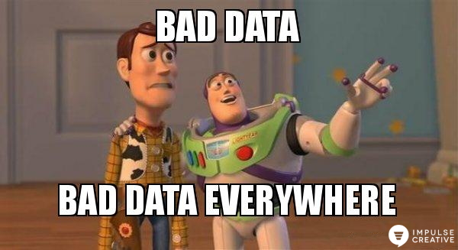
INDEX.HTML
Notes:
Difficulty working with names: trait d’union, titles, long names, inconsistency, with names that are longer, weird accents,
The diversity of Europe

